Slide 1
NYC Tech Talent Pipeline Android App
By
William K. Pescherine

Slide 2
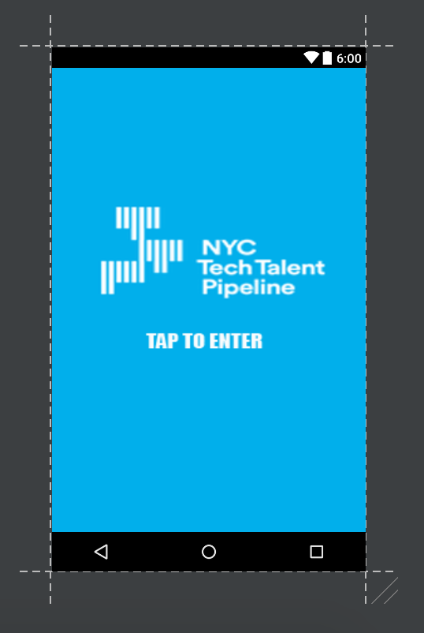
NYC Tech Talent Pipeline
The Idea of the app is to have a gateway application that allows for people to download this. And get started on connecting with the Tech talent Pipeline. As well as an avenue for people who might be on the edge to look over things And get some idea of what is required. Also have created a path for people to get started who have never done any coding before/

Slide 3
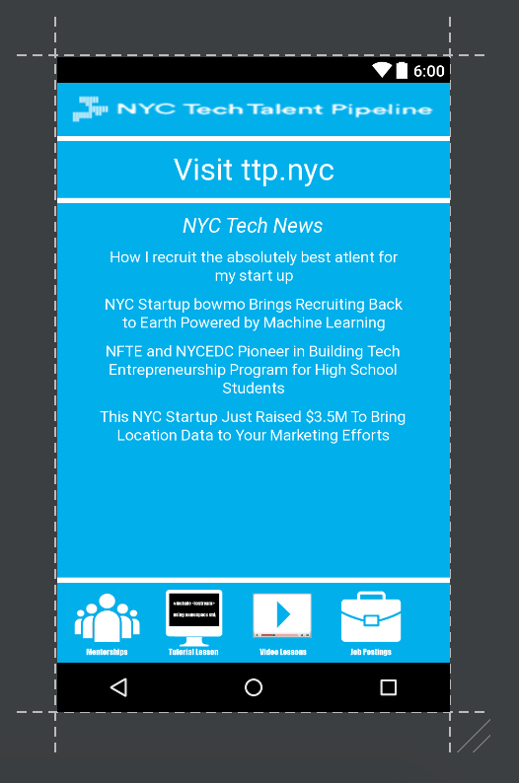
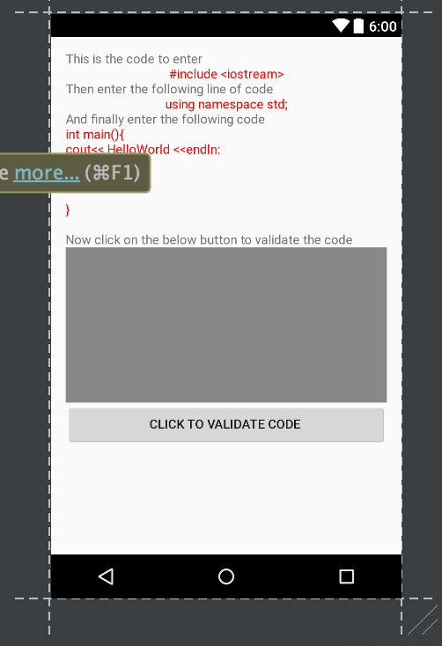
NYC Tech Talent Pipeline
A direct in App link to ttp.nyc
A news feed for current events in tech for NYC
A mentor section
Video lesson section
Tutorial Lesson Section
Job Postings

Slide 4
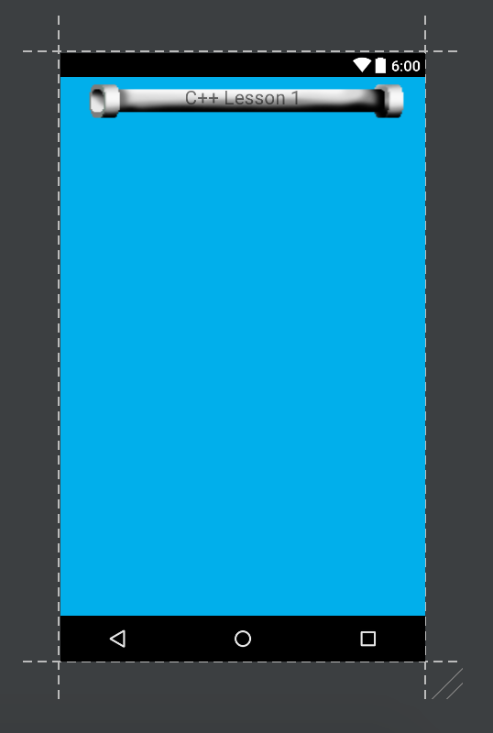
NYV Tech Talent Pipeline
Tutorial Section
Both Video and Walkthru Section
Can be designed for any languages
Walkthru Section will include an area to practice in
Will have a button to allow for validation of code.

Slide 5
NYC Tech Talent Pipeline
Mentorship section can be used to allow people to have access to people already in the industry and willing to spare some time with advice
Job Postings can be used to help people to learn what is out there and to have another avenue to search for help within
Possible additions….
Add in college information and contacts for people to get advice from
Can also add in other learning sources for people to look into such as stackoverflow, codeacdemy, or even youtube

